Slide 1
Assembly Language
Lab 4
2022/10/10

Slide 2
Objectives
There are two PROC, Convert and Convert2
store a value in esi register then change 0 to A, 1 to B, 2 to C and so on,
Convert PROC USES ___ ;Convert change myID value 0-A 1-B and so on.
L1:
;Do something
loop L1
ret
Convert ENDP
Convert2 PROC ;Convert2 do the same thing as ConvertL1:
L1:
;Do something
loop L1
ret
Convert2 ENDP

Slide 3
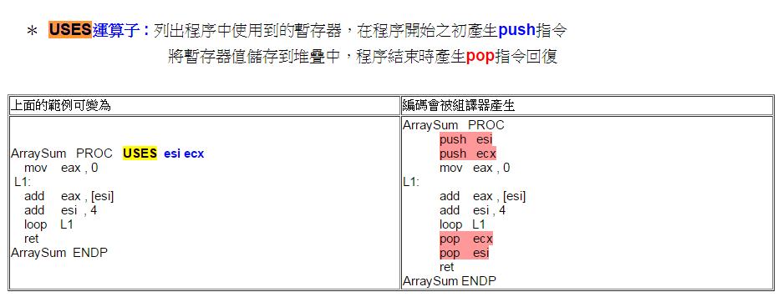
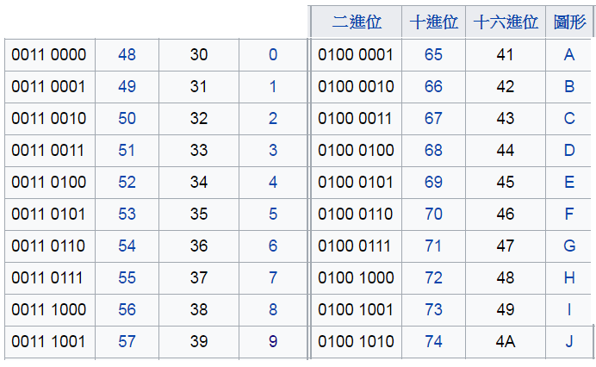
Hint
The use of push and pop instructions needs to be considered to avoid repeated execution of unnecessary instructions
USES operator: List the temporary registers used in the program, generate a push instruction in the beginning of the program, store value of the temporary register into the stack, generate a pop instruction reply at the end of the program
Sample Program | The code will be generated by the assembler
Binary | Decimal | Hexadecimal | Character
Binary | Decimal | Hexadecimal | Character
ASCII CODE

Slide 4
Hint
Binary | Decimal | Hexadecimal | Character
ASCII CODE

Slide 5
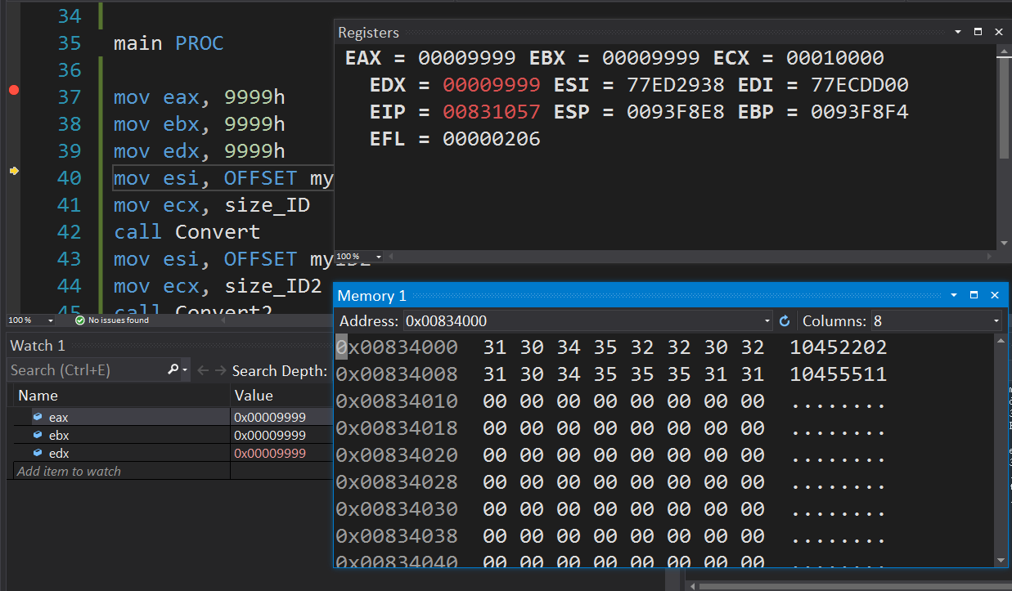
Initial State

Slide 6
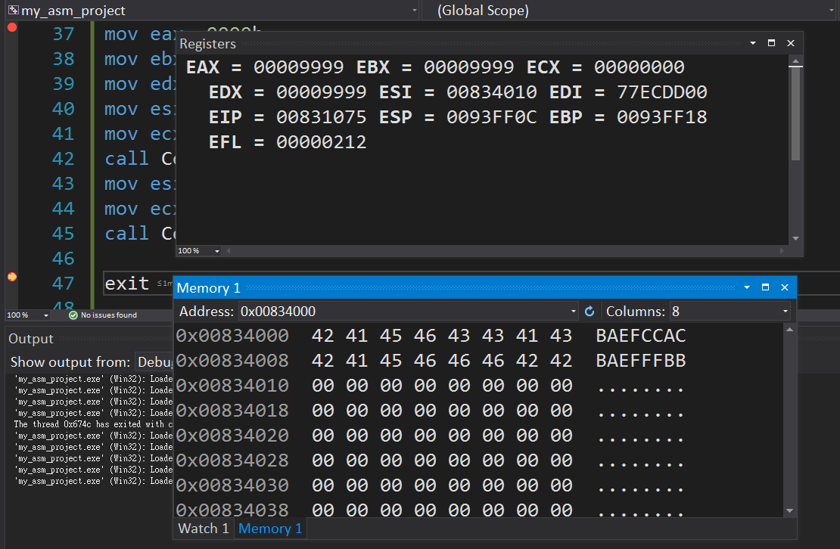
Program Result

Slide 7
Report
Due to 2022/10/11
Before 12:00
If you submit late, please send a letter to the teaching assistant, points will be deducted
Group Task
Compress(.zip,.rar) the following file with the name of the group ( e.g. lab4_01.zip)
Code(lab4_01.asm)
Report(lab4_01.doc or lab4_01.pdf)
Report Title
Group, name, student ID
Step by step of program execution flow, memory (register) status
Screenshots description, code Description
Reviews for the class, lesson learned, the tools we used, TA, etc

Slide 8
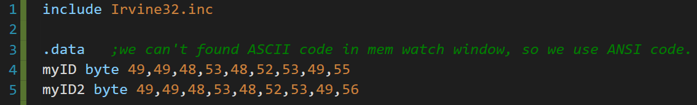

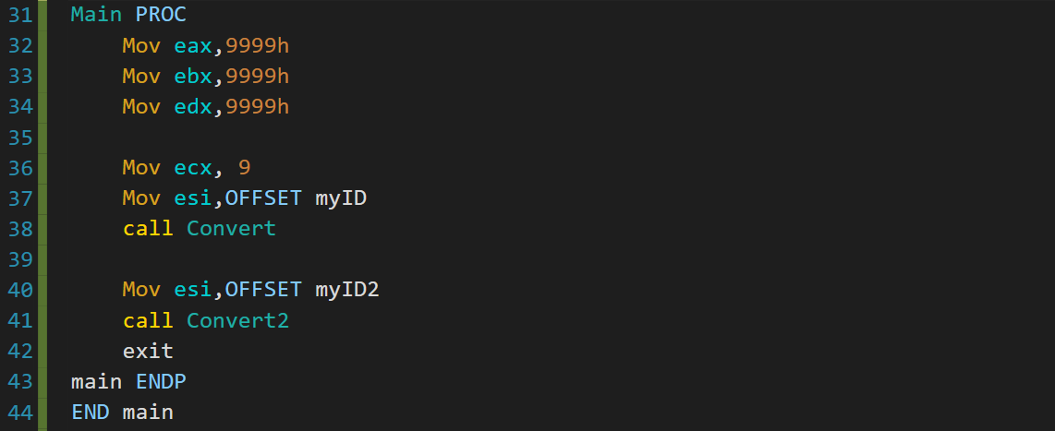





Slide 9
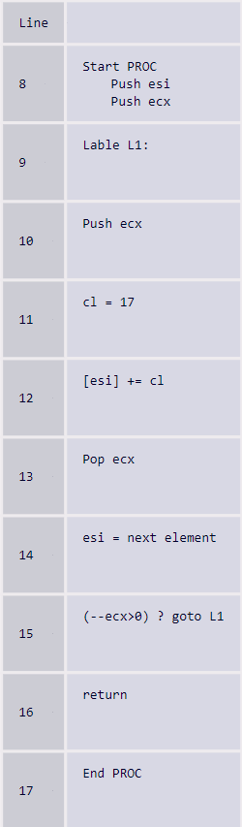


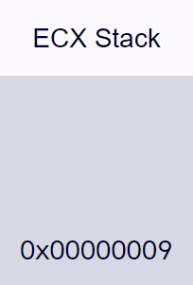

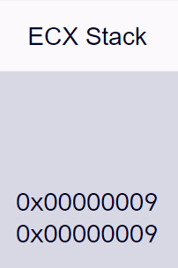







Here we create a function called Convert which pushes and pops esi & ecx at the beginning and at the end of it
Here we indicate were the loop needs to start
Here we push ecx writing it in the stack for us to write into cl later
Here we move a 17 value to cl
Here we add cl to the designated esi position, we add 17 because we are using ANSI code, and in ANSI code we need to add 17 instead of adding 11 as in ASCII code.
Here we pop ecx to restore its default value
Here we add one to the esi to inform that we executed the loop one more time
Here we go back to L1 if the loop isn’t finished
If it is finished then we just return
Here we just END the function, and it pop ecx & esi’s value before PROC start. (Line8 USES esi ecx)

